Slide 1
Existing research on similar data

Slide 2
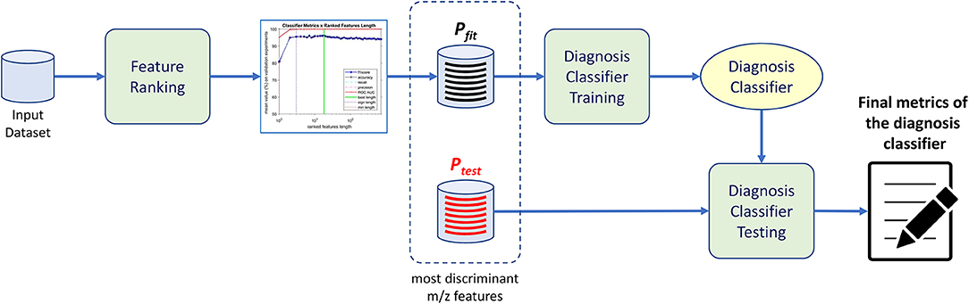
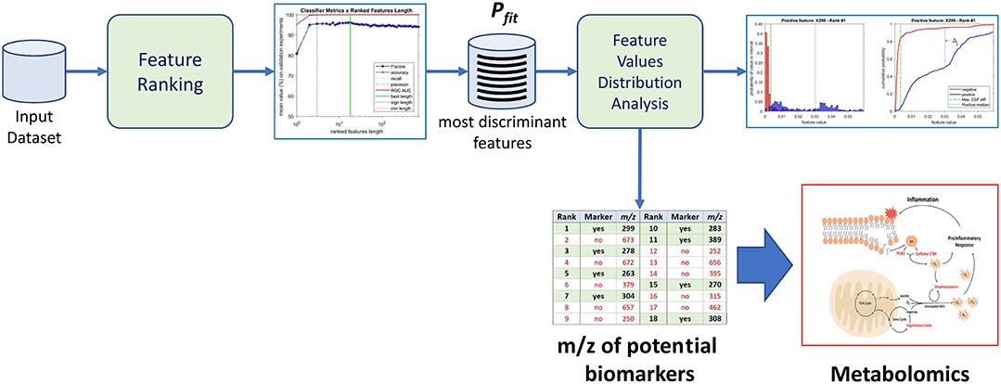
Existing research: Combining Machine Learning and Metabolomics to Identify Weight Gain Biomarkers
https://www.frontiersin.org/articles/10.3389/fbioe.2020.00006/full#B16
Problem Statement: Finding molecules that may be involved in development of obesity using machine learning techniques.
Data Analysed:
Mass Spectrometry* analysis data of the plasma of 180 Brazilian individuals.
After the Gauss Jordan elimination , 713 ions remained represented in the feature vectors from the original 1,752 m/z values
Data Technique:
Random forest classifier is used.
Gauss Jordan elimination used on linearly dependent features.
Using feature importance to find the most discriminant features on the mass spectra in predicting patients with weight gain conditions.
Machine learning performed to
  Generate a diagnosis classifier to screen patients (Fig 1)
  Determine potential biomarkers. (Fig 2)
Grid Search used to for hyperparameter optimisation
8 of the 18 features most discriminant features were identified as markers that then underwent metabolomics techniques to identify weight gain biomarkers
5 weight gain biomarkers were found, and biological relationships between them and weight gain were then proposed
Novelty:
Application of machine learning on a novel problem and dataset
Using ML to find biological relationships for the purposes of diagnosis and proposal of biological pathways.
*Mass spectrometry is an analytical tool useful for measuring the mass-to-charge ratio (m/z) of one or more molecules present in a sample. These measurements can often be used to calculate the exact molecular weight of the sample components as well.
The ‘m’ and ‘z’ in m/z stands for mass and charge number of ions respectively
Figure 1: Pipeline for generating a diagnosis classifier to screen patients
Figure 2: Pipeline for determining potential biomarkers

Slide 3
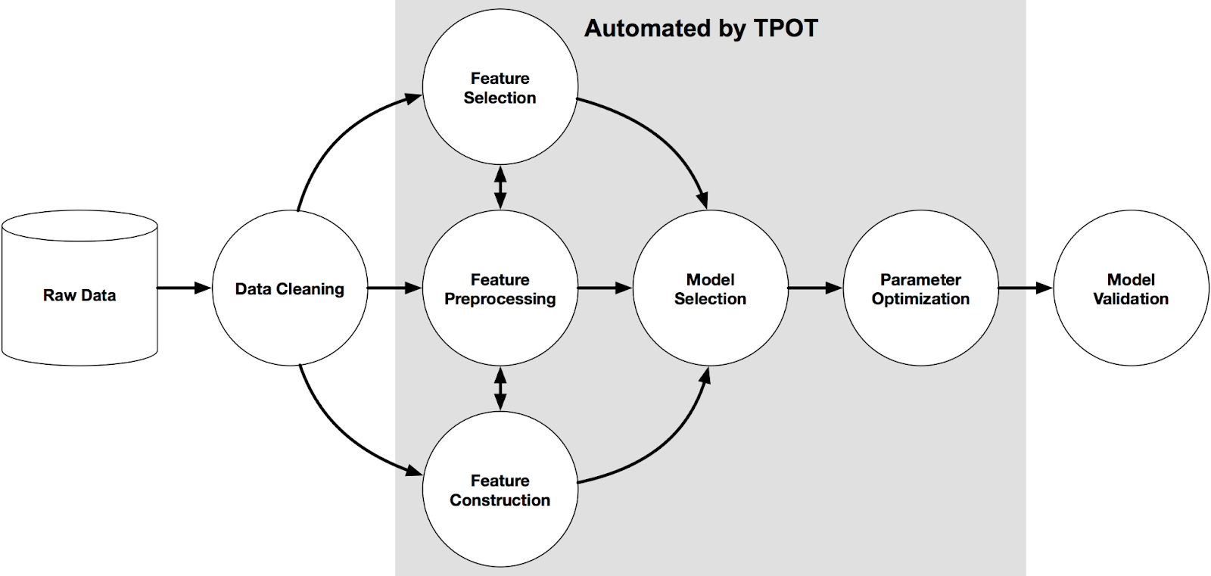
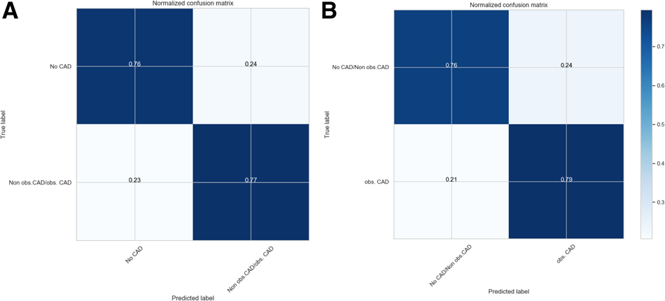
Existing research: Model selection for metabolomics: predicting diagnosis of coronary artery disease using automated machine learning
https://academic.oup.com/bioinformatics/article/36/6/1772/5614811
Problem Statement: Selection of an optimal machine learning model for predicting angiographic diagnoses of coronary artery disease
Data:
Nuclear magnetic resonance-derived lipoprotein and metabolite profiles in the Angiography and Genes Study (ANGES) cohort, which enrolled 1000 patients referred to coronary angiography at Tampere University Hospital (Finland) between September 2002 and July 2005.
73 metabolic features, plus 27 demographic and clinical features.
Technique:
Pre-processing of data with KNN imputation strategy using fancyimpute python package (2016)
Use of TPOT (fig.1), a tree-based pipeline optimisation tool which employs genetic programming techniques, to find an optimal ML model.
Ran for 1000 generations or 24 hours, whichever comes first.
Use of permutation feature importance to calculate predictive ability of specific features. (fig.3, next slide)
Analysis of complexity-performance trade-off of pipelines from TPOT using confusion matrix.
Results from TPOT were compared with traditional grid-search optimisation of selected ML models. TPOT models were deemed superior. (fig.4, next slide)
Figure 1: Parts of ML pipeline automated by TPOT
Figure 2: Normalized confusion matrix for selected TPOT-optimized models for P1 dataset (A) and P2 dataset (B)

Slide 4
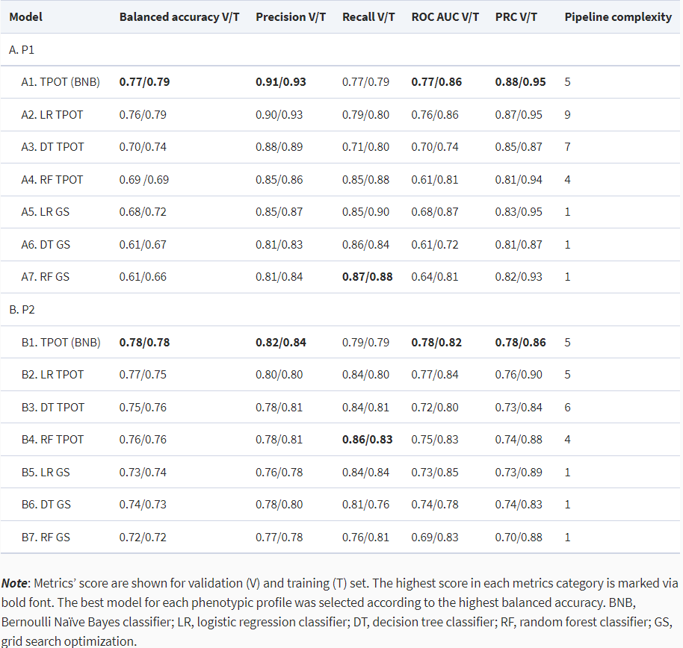
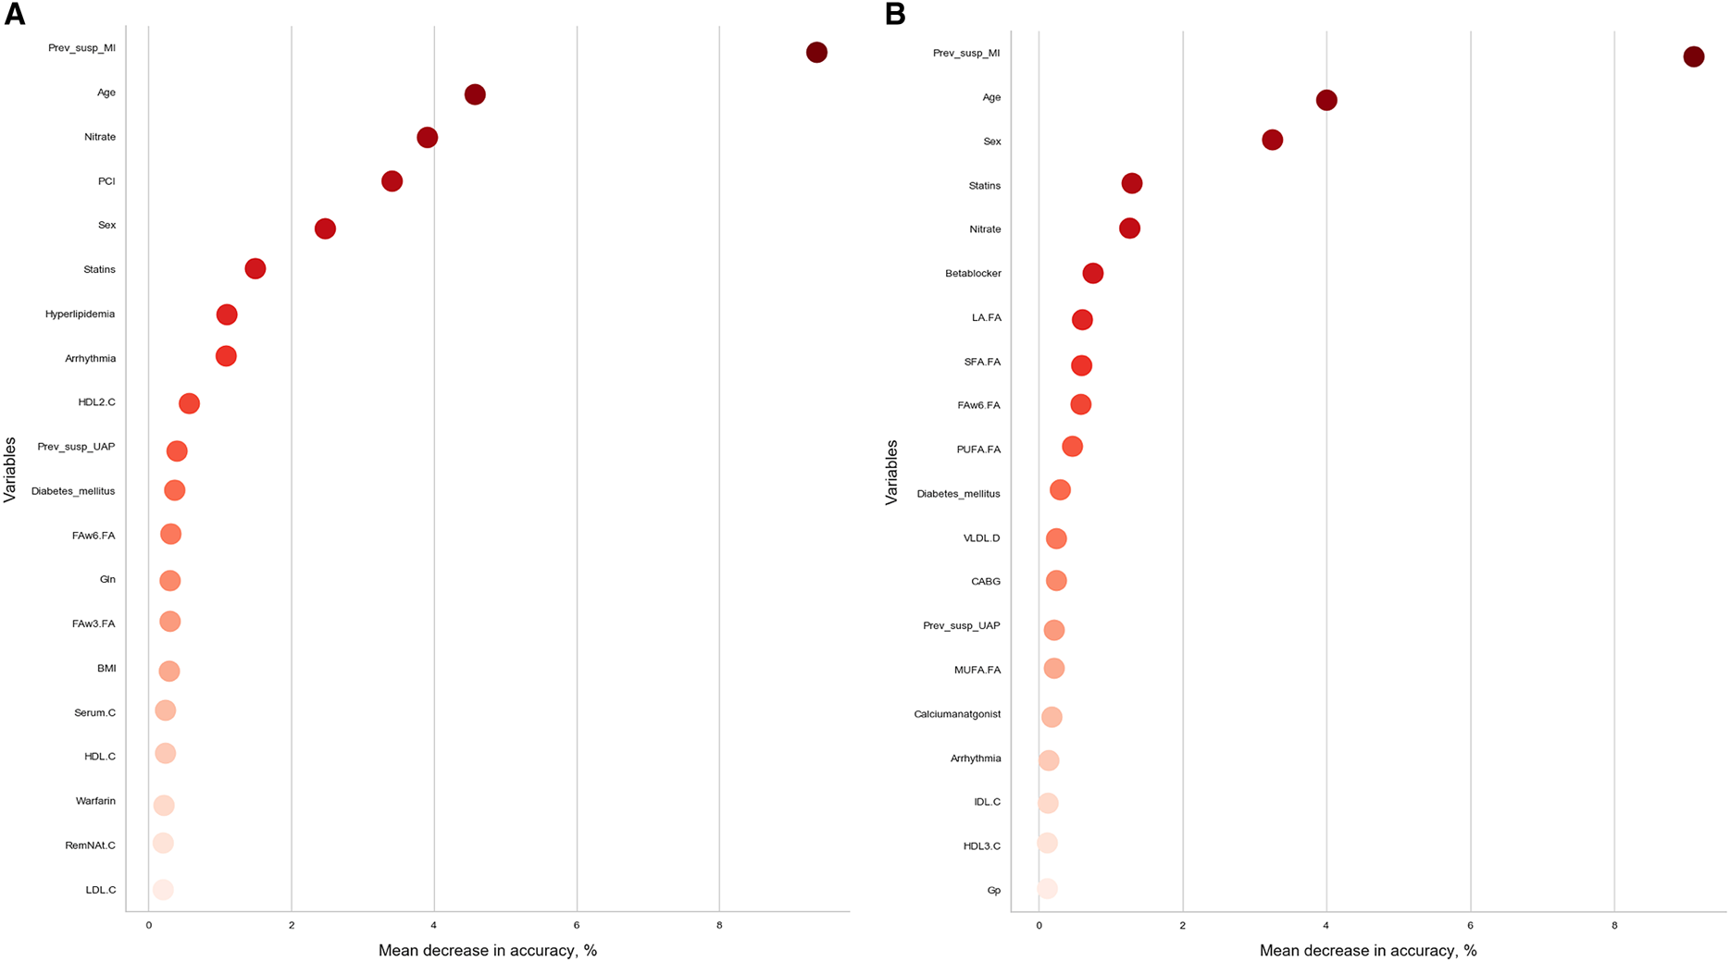
Existing research: Model selection for metabolomics: predicting diagnosis of coronary artery disease using automated machine learning
https://academic.oup.com/bioinformatics/article/36/6/1772/5614811
Conclusion:
“We demonstrated the power of agnostic model selection with the AutoML tool TPOT for CAD diagnosis prediction using clinical and metabolic data from the ANGES cohort. As a result, TPOT optimization automatically produced predictive models that outperformed grid search optimized models. We used selected models to show that phenotypic profile that distinguishes non-obstructive CAD patients from no CAD patients is associated with higher precision and subsequently have a different subset of predictive features than phenotypic profile that treats no CAD patients and non-obstructive CAD patients as the same outcome.
Novelty:
Relatively esoteric dataset
Use of relatively new and novel python-based ML tools like fancyimpute (2016) and TPOT (2018).
Figure 4: Comparative analysis of the TPOT optimization of selected model with various performance metrics for P1(A) and P2(B).
Figure 3: Feature importance coefficients produced by Model A1 for P1 dataset and by Model B1 for P2 dataset

